Slide 1
Stars, Galaxies, and the Universe

Slide 2
Last time
Most of the solar system’s planets:
Are made of rocks and minerals
Are made of gas
Revolve (orbit) around the Sun in the same direction
Rotate in the same direction as they orbit the Sun
3 and 4

Slide 3
Last time
Most of the solar system’s planets:
Are made of rocks and minerals
Are made of gas
Revolve (orbit) around the Sun in the same direction
Rotate in the same direction as they orbit the Sun
3 and 4

Slide 5
The physics on Earth applies in space.

Slide 9
To understand stars, we need to understand a bit about light…

Slide 13
Spreading out the light from a star
“Creating a spectrum”
Informs us what the surface temperature of the star is
Informs us on what atomic elements are present on the surface of the star.
The physics on Earth applies in space.

Slide 16
A star’s mass determines its destiny.

Slide 17
`
Brighter
Dimmer
Hotter
Cooler

Slide 20
Stars more massive than
150M_{Sun} would blow apart
Brighter
Luminosity
Stars less massive than
0.08M_{Sun} can’t sustain fusion
Degenerate Stars
Dimmer
Hotter
Temperature
Cooler

Slide 21
Stars of higher mass have higher core temperature and more rapid fusion, making those stars both more luminous and shorter-lived
Stars of lower mass have cooler cores and slower fusion rates, giving them smaller luminosities and longer lifetimes
Brighter
Dimmer
Hotter
Cooler

Slide 22
Life after the Main Sequence dividing the stars into groups
Low mass stars (0.08 – 8 Msun)
Planetary Nebula (to White Dwarf)
High mass stars (more than 8 Msun)
Supernova (to Neutron star or Black Hole)

Slide 24
The End of Lower Mass Stars
Double-shell burning ends with a pulse that ejects the H and He into space as a planetary nebula
Core temperature never grows hot enough for fusion of heavier elements
Degeneracy pressure supports the white dwarf against gravity

Slide 26
Life after the Main Sequence dividing the stars into groups
Low mass stars (0.08 – 8 Msun)
Planetary Nebula (to White Dwarf)
High mass stars (more than 8 Msun)
Supernova (to Neutron star or Black Hole)

Slide 27
Massive Stars: Party Hard, Live Fast, & Die Explosively

Slide 28
Galaxies and the Universe

Slide 29
Who has seen the milky way?
(not this one)

Slide 31
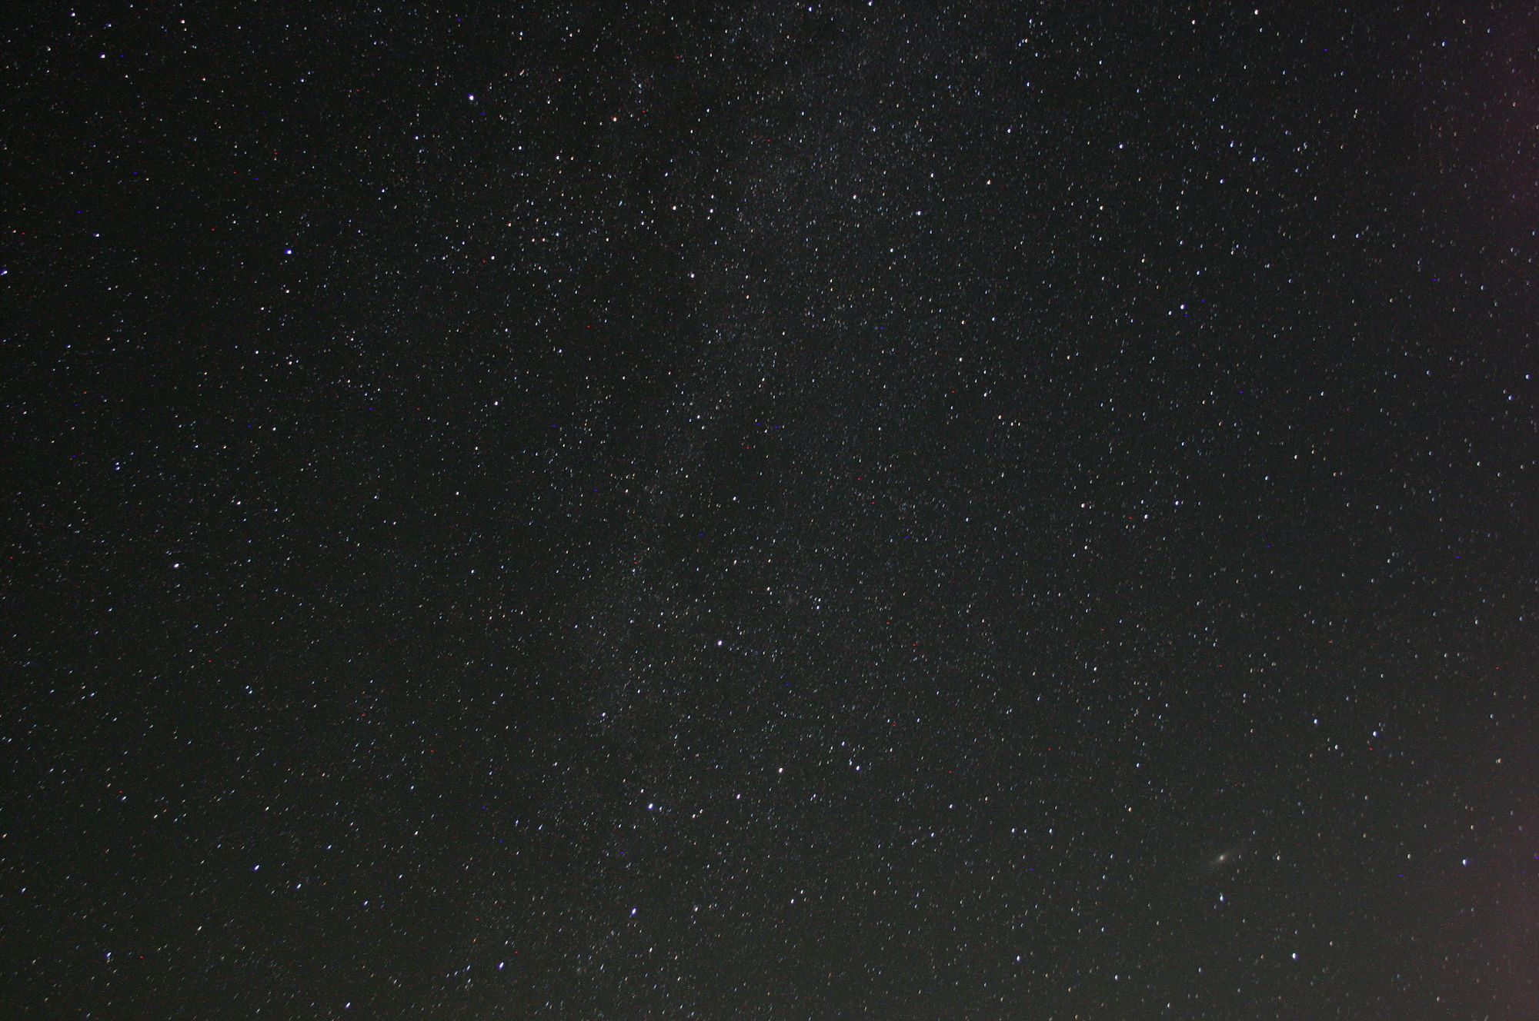

Slide 32
Andromeda Galaxy viewed with Hubble

Slide 35
Galaxies: Islands of Stars
What are the three major types of galaxies?
How are galaxies grouped together?

Slide 36
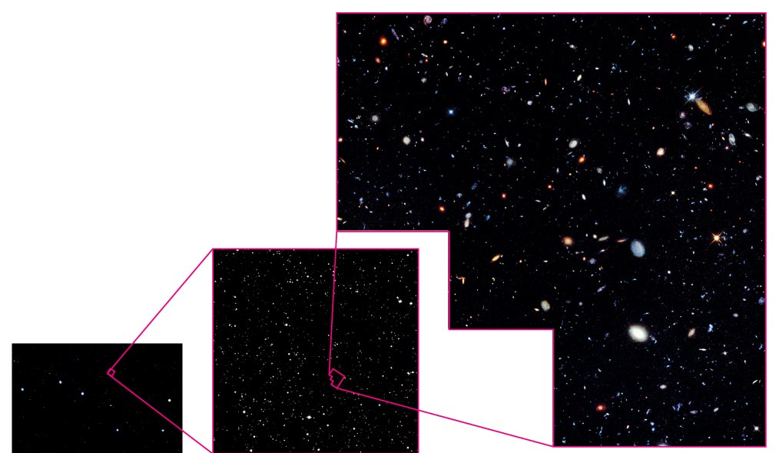
Hubble Deep Field
Our deepest images of the universe show a great variety of galaxies, some of them billions of light-years away

Slide 37
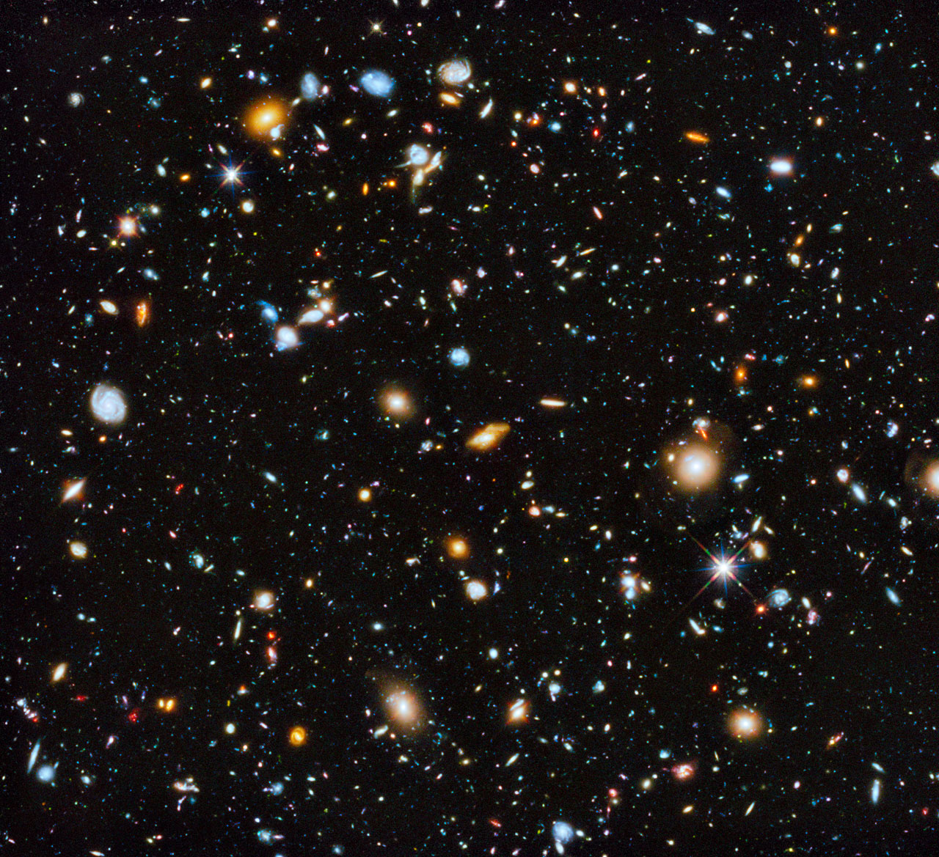
Galaxies and Cosmology
A galaxy’s age, its distance, and the age of the universe are all closely related
The study of galaxies is thus intimately connected with cosmology— the study of the structure and evolution of the universe

Slide 38
What are the three major types of galaxies?

Slide 39
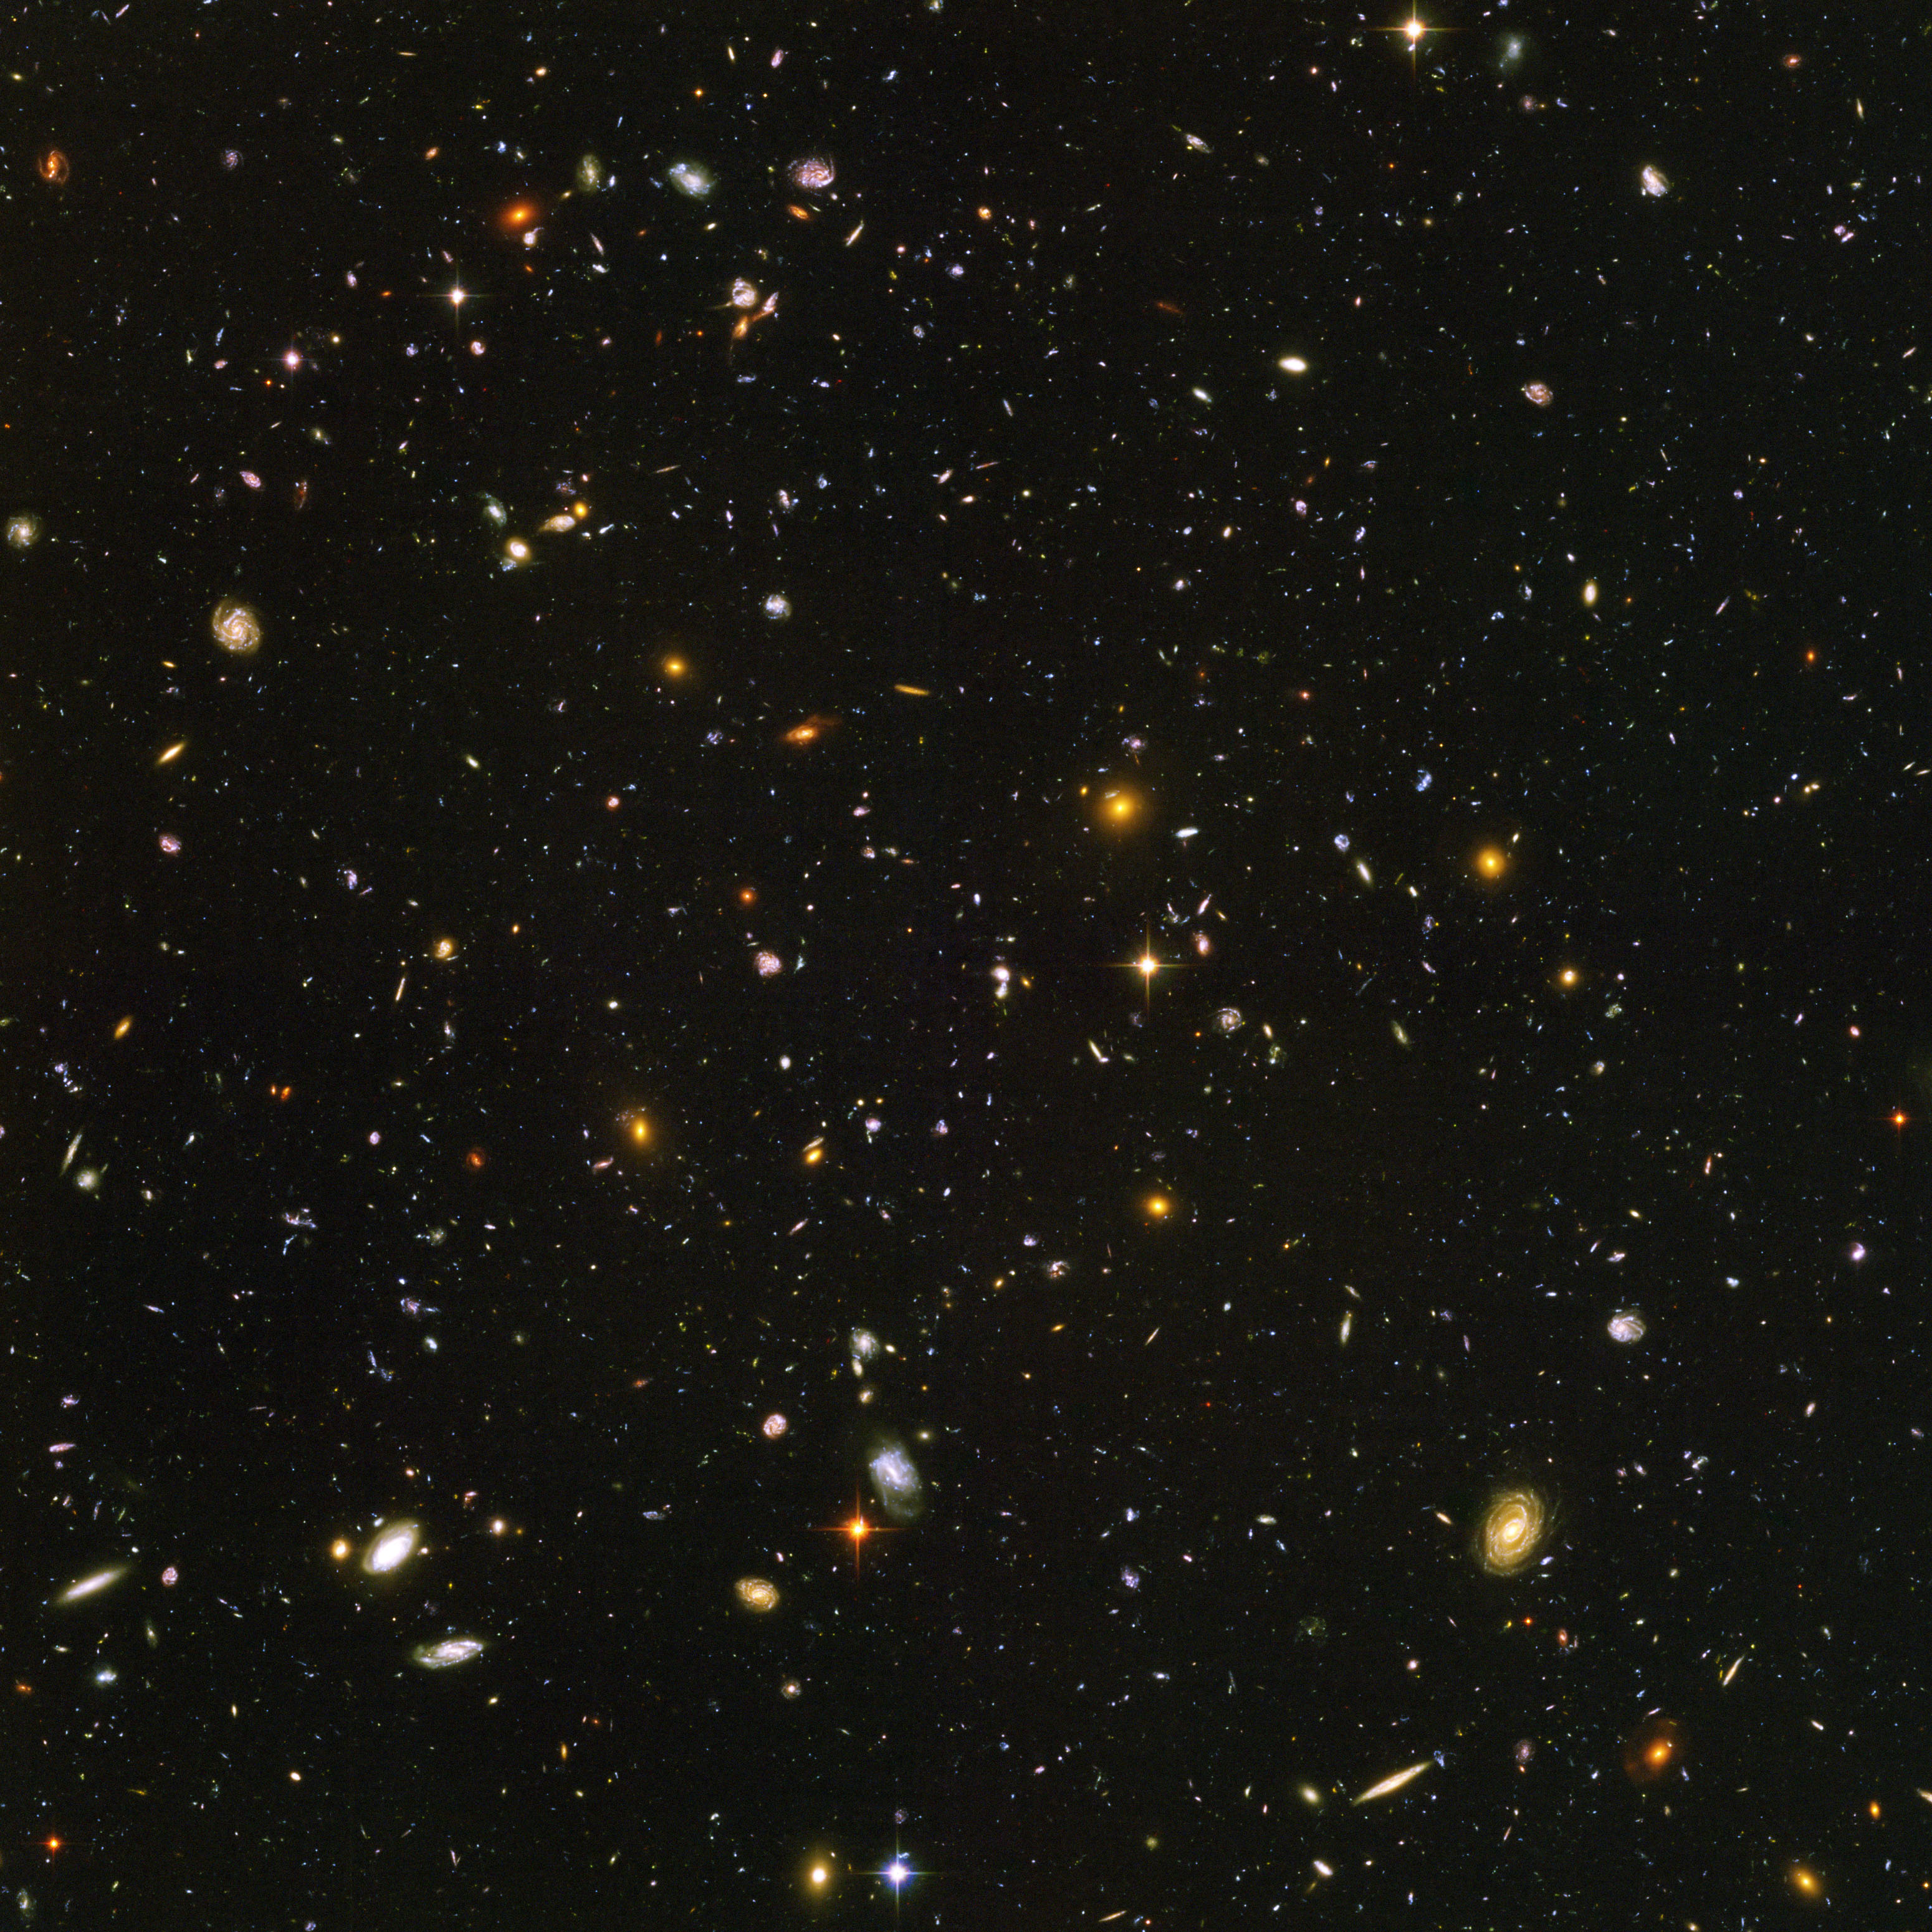
Hubble Ultra Deep Field

Slide 40
Hubble Ultra Deep Field

Slide 41
Hubble Ultra Deep Field
Spiral Galaxy

Slide 42
Hubble Ultra Deep Field
Spiral Galaxy

Slide 43
Hubble Ultra Deep Field
Elliptical Galaxy
Elliptical Galaxy
Spiral Galaxy

Slide 44
Hubble Ultra Deep Field
Elliptical Galaxy
Elliptical Galaxy
Spiral Galaxy

Slide 45
Hubble Ultra Deep Field
Elliptical Galaxy
Elliptical Galaxy
Irregular Galaxies
Spiral Galaxy

Slide 46
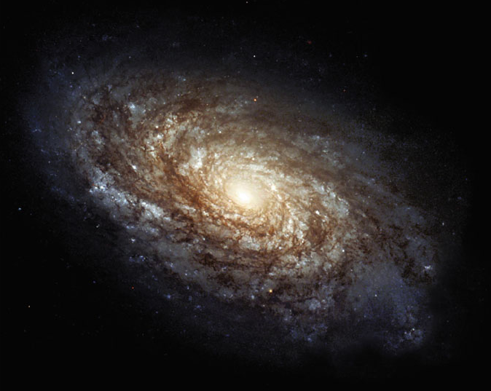
halo
disk
bulge
Spiral Galaxy

Slide 47
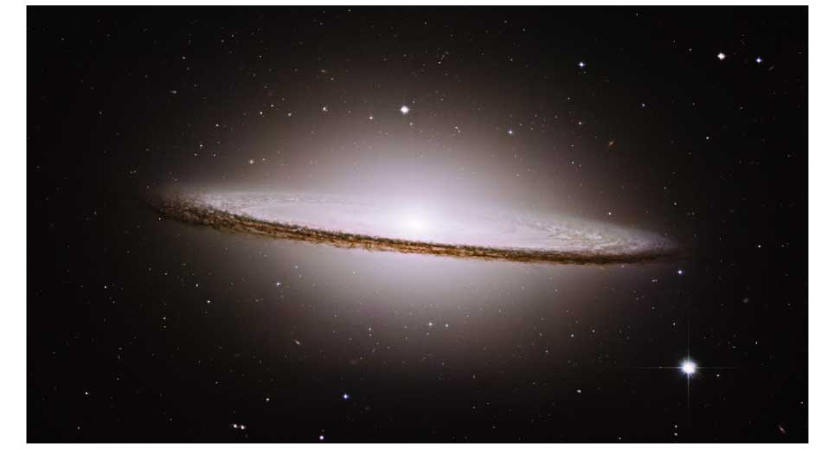
Disk Component:
stars of all ages,
many gas clouds
Spheroidal Component:
bulge & halo, old stars,
few gas clouds

Slide 48
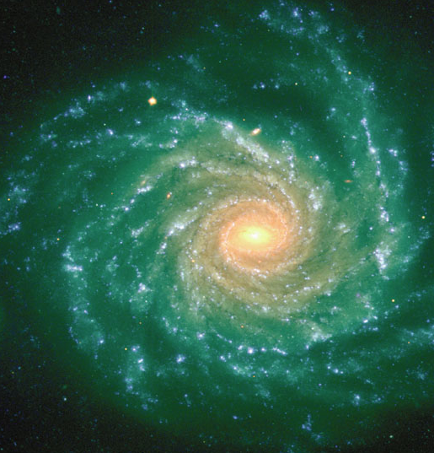
Disk Component:
stars of all ages,
many gas clouds
Spheroidal Component:
bulge & halo, old stars,
few gas clouds

Slide 49
Disk Component:
stars of all ages,
many gas clouds
Blue-white color indicates ongoing star formation
Spheroidal Component:
bulge & halo, old stars,
few gas clouds
Red-yellow color indicates older star population

Slide 50
Disk Component:
stars of all ages,
many gas clouds
Blue-white color indicates ongoing star formation
Spheroidal Component:
bulge & halo, old stars,
few gas clouds
Red-yellow color indicates older star population

Slide 51
Thought Question
Why does ongoing star formation lead to a blue-white appearance?
A. There aren’t any red or yellow stars
B. Short-lived blue stars outshine others

Slide 52
Thought Question
Why does ongoing star formation lead to a blue-white appearance?
A. There aren’t any red or yellow stars
B. Short-lived blue stars outshine others

Slide 53
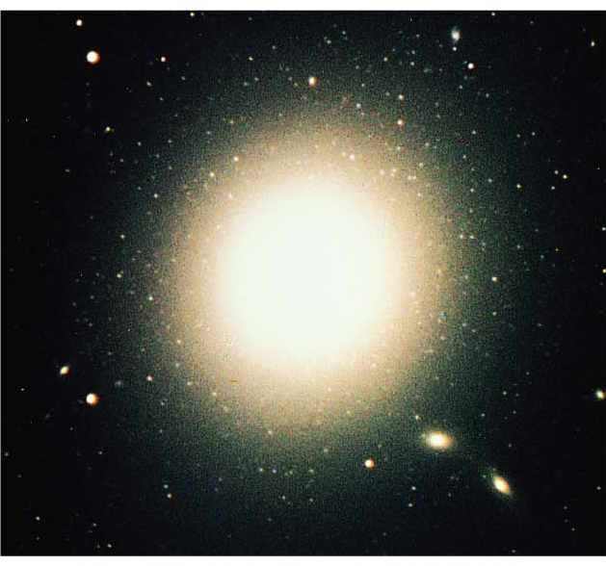
Elliptical Galaxy:
All spheroidal component, virtually no disk component

Slide 54
Elliptical Galaxy:
All spheroidal component, virtually no disk component
Red-yellow color indicates older star population

Slide 55
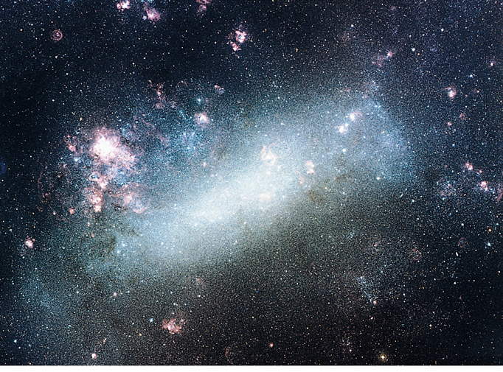
Irregular Galaxy
Blue-white color indicates ongoing star formation

Slide 56
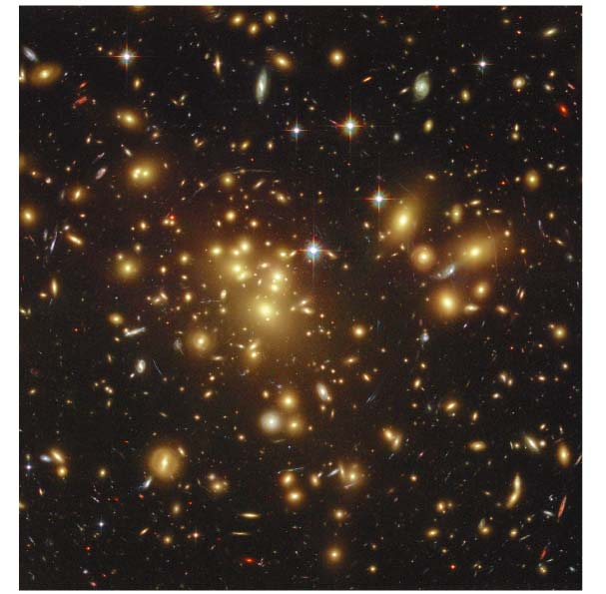
How are galaxies grouped together?

Slide 57
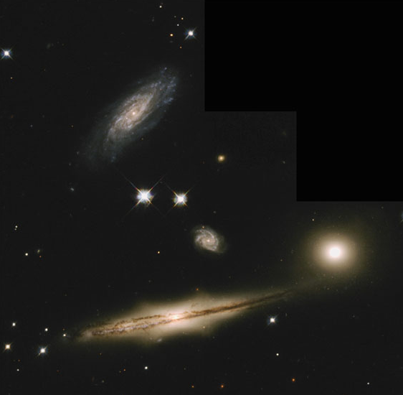
Spiral galaxies are often found in groups of galaxies
(up to a few dozen galaxies)

Slide 58
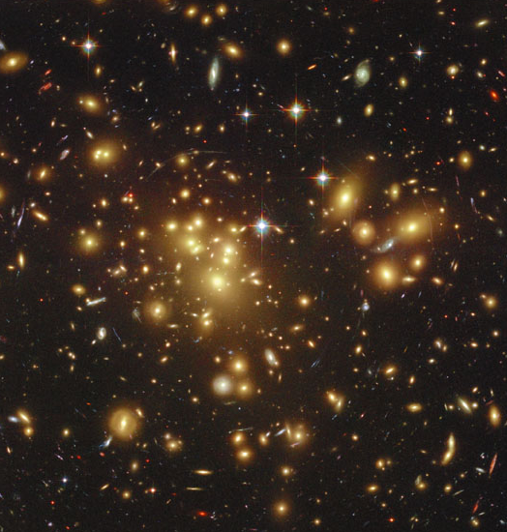
Elliptical galaxies are much more common in huge clusters of galaxies
(hundreds to thousands of galaxies)

Slide 59
What have we learned?
What are the three major types of galaxies?
Spiral galaxies, elliptical galaxies, and irregular galaxies
Spirals have both disk and spheroidal components; ellipticals have no disk
How are galaxies grouped together?
Spiral galaxies tend to collect into groups of up to a few dozen galaxies
Elliptical galaxies are more common in large clusters containing hundreds to thousands of galaxies

Slide 60
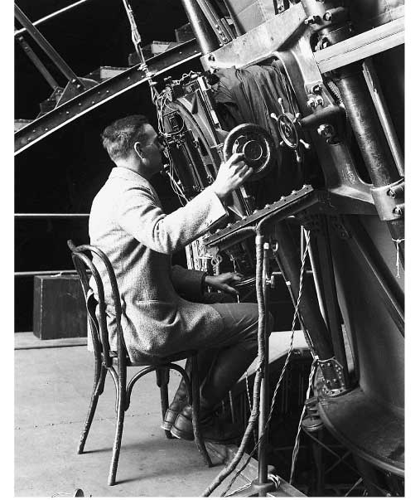
How did Hubble prove that galaxies lie far beyond the Milky Way?

Slide 61
The Puzzle of “Spiral Nebulae”
Before Hubble, some scientists argued that “spiral nebulae” were entire galaxies like our Milky Way, while others maintained they were smaller collections of stars within the Milky Way
The debate remained unsettled until someone finally measured their distances

Slide 62
Hubble settled the debate by measuring the distance to the Andromeda Galaxy using Cepheid variables as standard candles
While doing so, he discovered distant galaxies are moving away from us. The farther the galaxy, the faster it’s moving away.
The space between distant galaxies is growing. Our Universe is expanding.

Slide 63
How do we know?

Slide 65
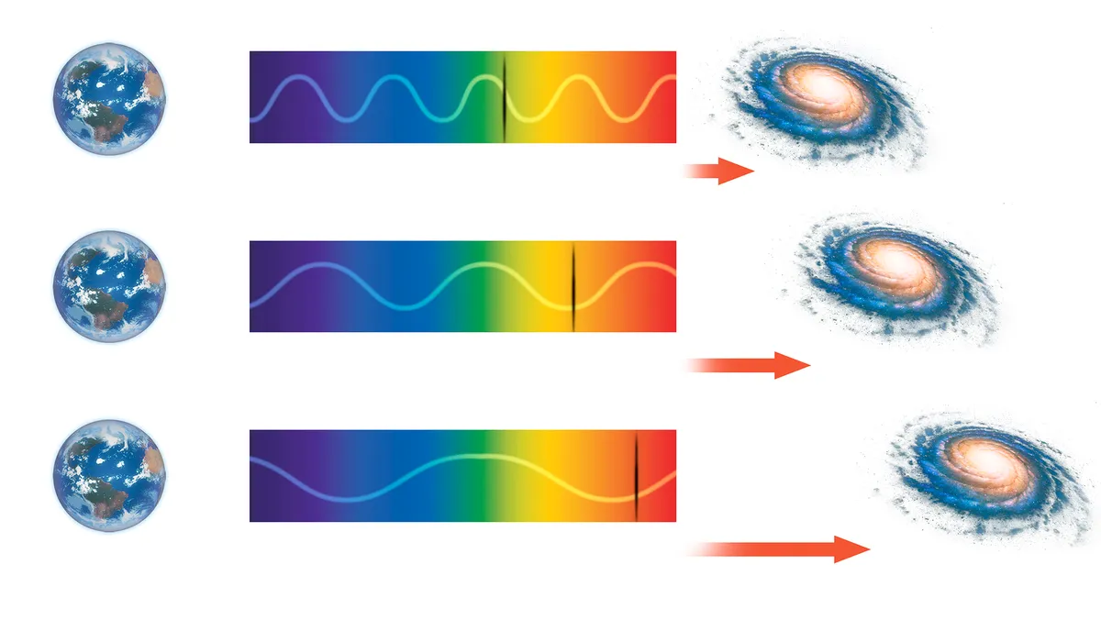
More redshift = faster speed away from Earth

Slide 66
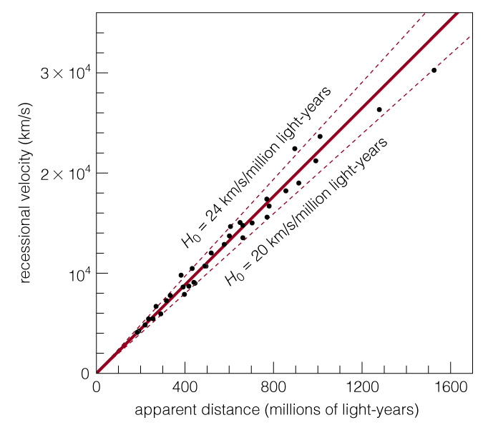
More redshift = faster speed away from Earth
Hubble’s Law: velocity = H₀ x distance

Slide 67
Our Universe is expanding…

Slide 68
The expansion rate appears to be the same everywhere in space
The universe has no center and no edge (as far as we can tell)

Slide 69
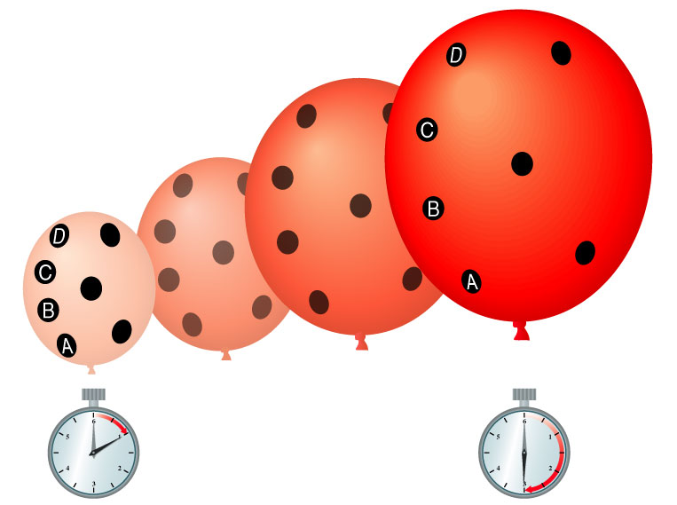
One example of something that expands but has no center or edge is the surface of a balloon

Slide 70
Cosmological Principle
The universe looks about the same no matter where you are within it
Matter is evenly distributed on very large scales in the universe
No center & no edges
Not proved but consistent with all observations to date

Slide 71
If time…

Slide 72
The Big Bang: The beginning of time
What were conditions like in the early universe?
The early universe must have been extremely hot and dense

Slide 73
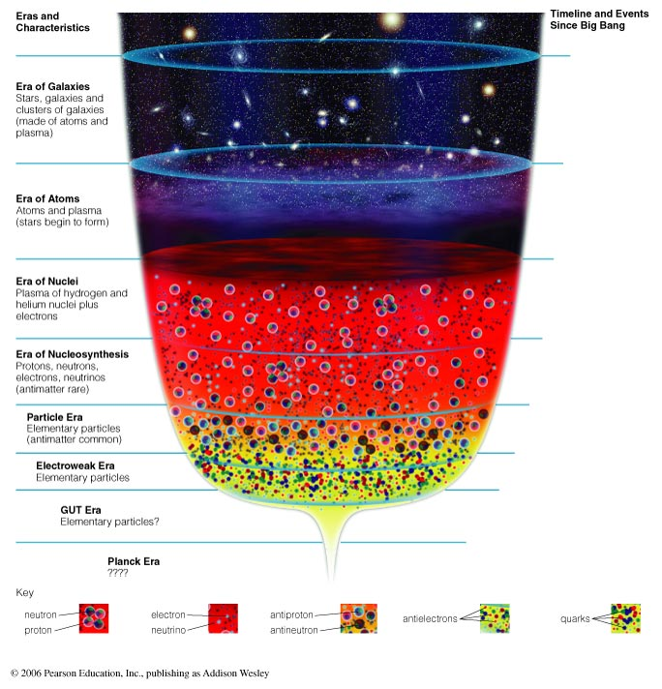
What is the history of the universe according to the Big Bang theory?

Slide 74
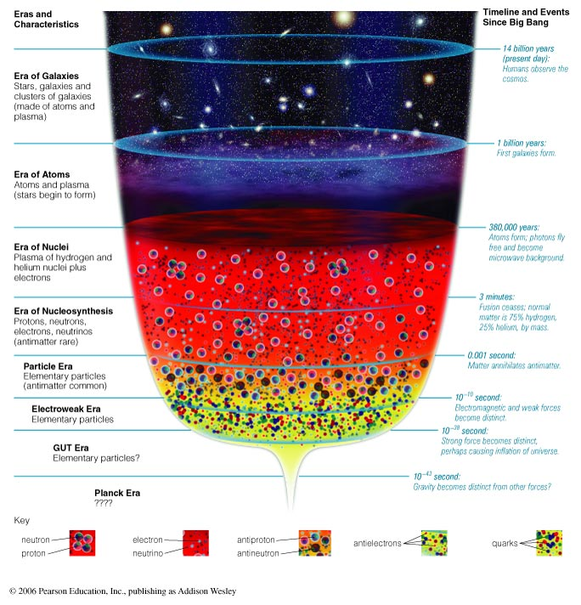

Slide 75
Planck Era
Before Planck time (~10⁻⁴³ sec)
No theory of quantum gravity

Slide 76
Particle Era
Because of the high temperatures the universe was a soup of high-energic particles

Slide 77
Era of Nucleosynthesis
As the Universe expands and cools:
Nuclei begin to fuse
75% Hydrogen, 25% Helium
(trace amounts of Lithium)

Slide 78
Era of Nuclei
Helium nuclei form at age ~ 3 minutes

Slide 79
Era of Atoms
First stars
Atoms form at age ~ 380,000 years
Background radiation released

Slide 80
Era of Galaxies
Galaxies form at age ~ 1 billion years

